Slide 2
Learning Outcomes
arrays
one dimension array
two dimension array

Slide 3
Array
An array is variable that can store multiple values.
Arrays a kind of data structure that can store a fixed-size sequential collection of elements of the same type.
Array is non-primitive data type. (int, float, char etc.)
Arrays consist of contiguous memory location.

Slide 4
Syntax
datatype name_of_array[size];
Datatype
Name of array
Size (integer)

Slide 5

Array Initializing and Memory Representation of an Array
int arr[5]={ 10,11,12,13,14};
arr 0 1 2 3 4 index
arr[0] arr[1] arr[2] arr[3] arr[4]

Slide 6

Access Array Elements
Array elements access by indices.
Suppose you declare an array arr as above than first element is arr[0], second element is arr[1] and so on.
arr[0] arr[1] arr[2] arr[3] arr[4]

Slide 7
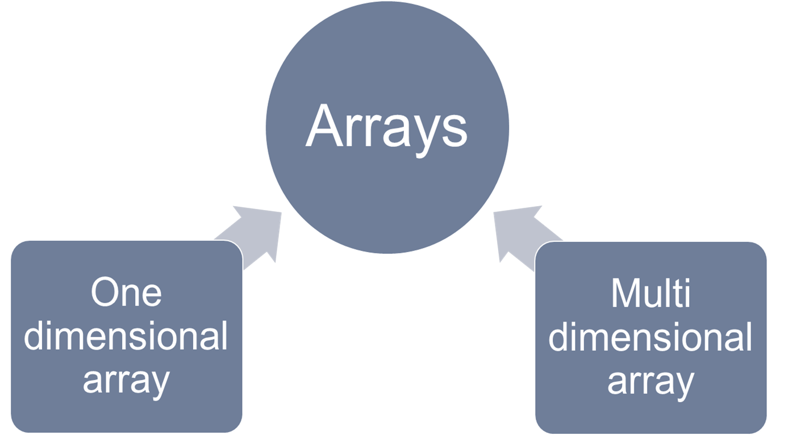
Type of Array

Slide 8
Type of Array
One dimensional Array
int a[5];
Multi-dimensional Array
int m[3][3];

Slide 9
Two Dimensional Array in C
An array of arrays is known as two dimensional array.
Two dimensional array in C language organized as matrices which is used in C programming to represent rows and columns.

Slide 10
Declaration of Two Dimensional Array in C
data_type name_of_array[rows][columns];
Datatype
Name of array
rows (integer)
columns (integer)
Number of elements in 2D arrays is multiply of rows and columns for eg. Int x[3][3] has 3*3 i.e. 9 elements.

Slide 11
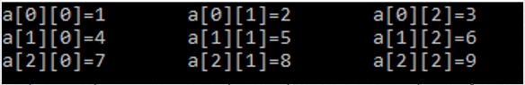
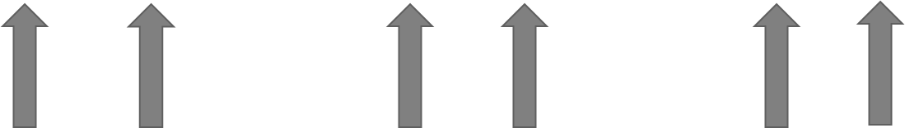
Array Initializing and Memory Representation of an Array
int x[3][4] = {{1,2,3}, {4,5,6}, {7,8,9}};
Index Value
Index Value
Index Value

Slide 12
Advantages of 2D Arrays
2D Arrays represent multiple data items of the same type in the form of matrix.
We can perform all matrices operation, sum of matrix, transpose of matrix using 2D Array.

Slide 13
Advantages of Arrays
Arrays represent multiple data items of the same type using a single name.
Elements of array can be accessed randomly by using the index number.
Easy access to all the elements.
Sorting and searching becomes easy.

Slide 14
Applications of Array
Arrays can be used for CPU scheduling.
Arrays can be used for reverse data elements, sort data elements etc.
Arrays are used to Perform Matrix Operations
Arrays are used to Store List of values
Arrays are also used to implement stack and queues.

Slide 15
Program: One Dimension Array
#include <stdio.h>
int main()
{
int arr[5]={10,11,12,13,14};
for(int i=0;i<=4;i++)
{
printf("%d\n",arr[i]);
}
return 0;
}

Slide 16
Program: Two Dimension Array
#include <stdio.h>
int main()
{
int x[3][4] = {{1,2,3}, {4,5,6}, {7,8,9}};
int i,j;
for( i=0;i<=2;i++)
{
for(j=0;j<=2;j++)
{
printf("%d\t",x[i][j]);
}
printf("\n");
}
return 0;
}

